Slide 1
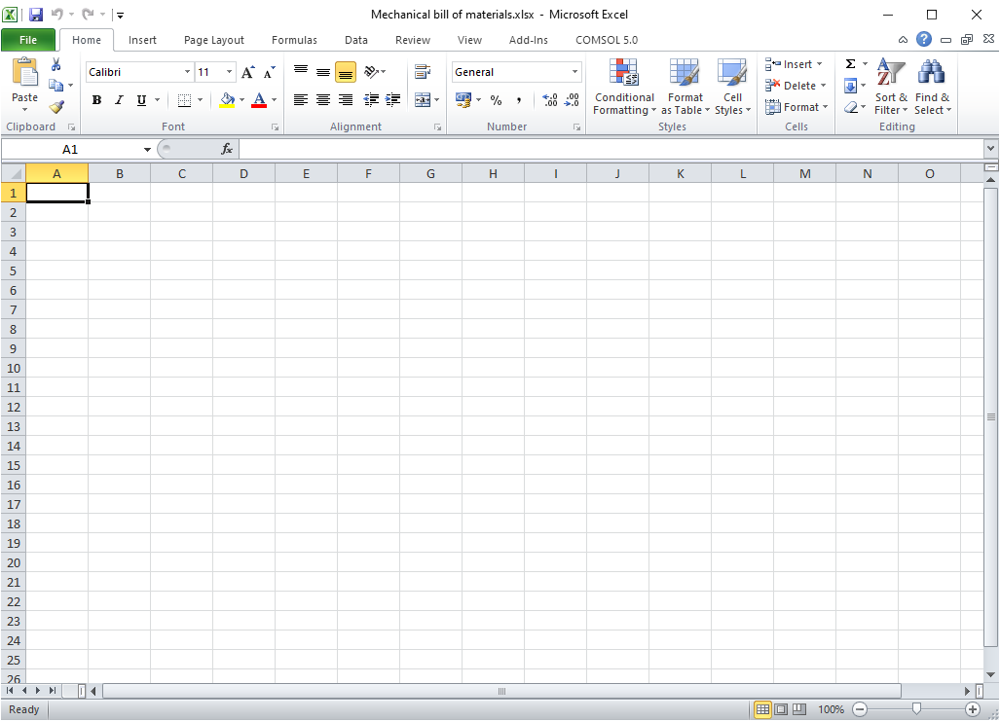
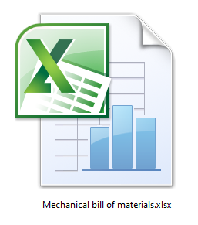
LINK – CLICK TO OPEN/DOWNLOAD FILE

